Slide 1
Instructions for Home Sleep Apnea Testing (HSAT)

Slide 2
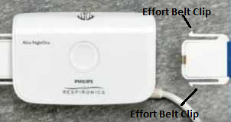
Connect Effort Belt Sensor
• Place the device in the middle of your chest (for women, above breasts) and wrap the blue belt under your arms and around your torso.
• Fasten the white clip at the end of the belt into the side of the device until you hear the belt click (figure 1). The device is now ON.
• Ensure that both clips on belt connector are firmly plugged in. Tug on the belt to make sure connection is solid.

Slide 3
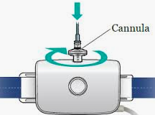
Connect Nasal Sensor (Cannula) to the device
• Screw the cannula connector into the metal airflow port on the top of device. Tighten connector down until secure.
The metal airflow port doesn’t look threaded, but the cannula will still screw on.

Slide 4
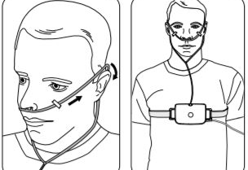
Insert cannula into the nose
• Fit the nasal sensor (cannula) so the two clear, small, open tubes point toward your nostrils.
Loop tubing over each ear and pull the plastic slide under your chin.
Use two pieces of tape to secure tubing to your
cheeks.

Slide 5
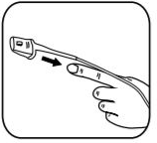
Insert Finger into Finger Probe
Insert your finger so it reaches the end of the sensor without poking through the hole.
Make sure the white cord goes along the top of your hand. Secure it to your finger and back of your wrist with two pieces of tape.
Note: A RED LIGHT inside the gray finger probe hood is normal and indicates that the device is on and recording.

Slide 6
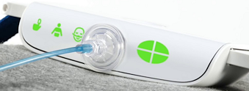
Once the device is ON, lights on the top left of the device correlating to three sensors will begin flashing. These lights will turn solid green, then shut OFF after a few minutes, so as not to interrupt your sleep.
- If you only see a + sign on the top of the device, this is indicating the device has battery power but is not turned on. The belt needs to be re-clipped.
-If you see any yellow flashing lights, re-apply, or adjust the corresponding sensor.

Slide 7
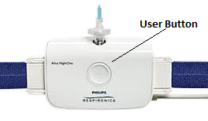
Checking To See If The Device Is On
The light will go out on the top of the device after a few minutes. This is a normal feature of the device. The lights on the top of the device go out so your sleep isn’t disrupted.
To check if the device is on, push the large circular user button on the front of the device for 1 second and release (Do not hold the button in). After releasing the button, you should see the 3 green sensor lights on the top of the device. If you don’t see the 3 sensor lights, re-clip the belt.

Slide 8
In The Morning
Remove all sensors, dispose of nasal cannula, and put equipment back in the box or bag in which you received it. The device will shut off on its own within 30 minutes (it's normal to see flashing lights on the top of the device during this time). Return the device and patient evaluation survey as instructed.
We expect that you may not sleep as well tonight as you normally do. Even so, it's important to wear the device all night (at least 7 hours) so that any sleep you do get is recorded.

Slide 9
Frequently Asked Questions
Q: There are YELLOW or GREEN lights intermittently appearing on the top of the device. What should I do?
A: Make sure the belt is fully clipped into the side of the device. Once that is done, don’t worry! It's common for yellow or green lights to appear, especially while you're awake. They may appear if you are moving around, holding your breath, or talking, and do not signify a failed study. Continue to sleep with the device and return the device as instructed.

Slide 10
Frequently Asked Questions
Q: What do I do if I need to get up during testing?
A: You are able to get up during testing, just make sure to keep the device on all night.

Slide 11
Frequently Asked Questions
Q: What if I sleep on my stomach?
A: You can slide the belt so the device is on your side and out of the way.

Slide 12
For further assistance with HSAT device set-up please call: (617) 581-6488

